Slide 1

TELVEXIA
Telvexia Workforce
Enterprise Workforce, Payroll & Compliance Platform for Nigerian Businesses
Powered by TaxCore™

Slide 2

The Workforce Management Challenge
Manual PAYE and statutory calculations create audit risk
HR data disconnected from payroll drives errors and rework
Month-end close delayed by spreadsheets and email approvals
Regulatory changes outpace legacy systems and consultants
Leaders lack a single source of truth for workforce costs and compliance
Telvexia Workforce — telvexia.com

Slide 3
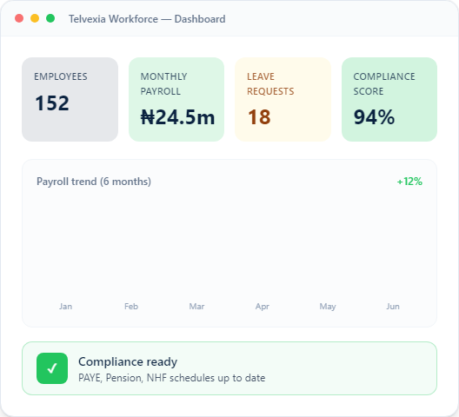
Why Enterprise Organisations Choose Telvexia
Enterprise Ready — multi-tenant architecture built for scale
Compliance First — Nigeria statutory automation from day one
API Enabled — developer keys, webhooks, and organisation tokens
Integration Ready — accounting, payments, and connected apps
Secure by Design — RBAC, approvals, audit logs, tenant isolation
Powered by TaxCore™ — Nigeria's intelligent payroll and compliance engine
Telvexia Workforce — telvexia.com

Slide 4
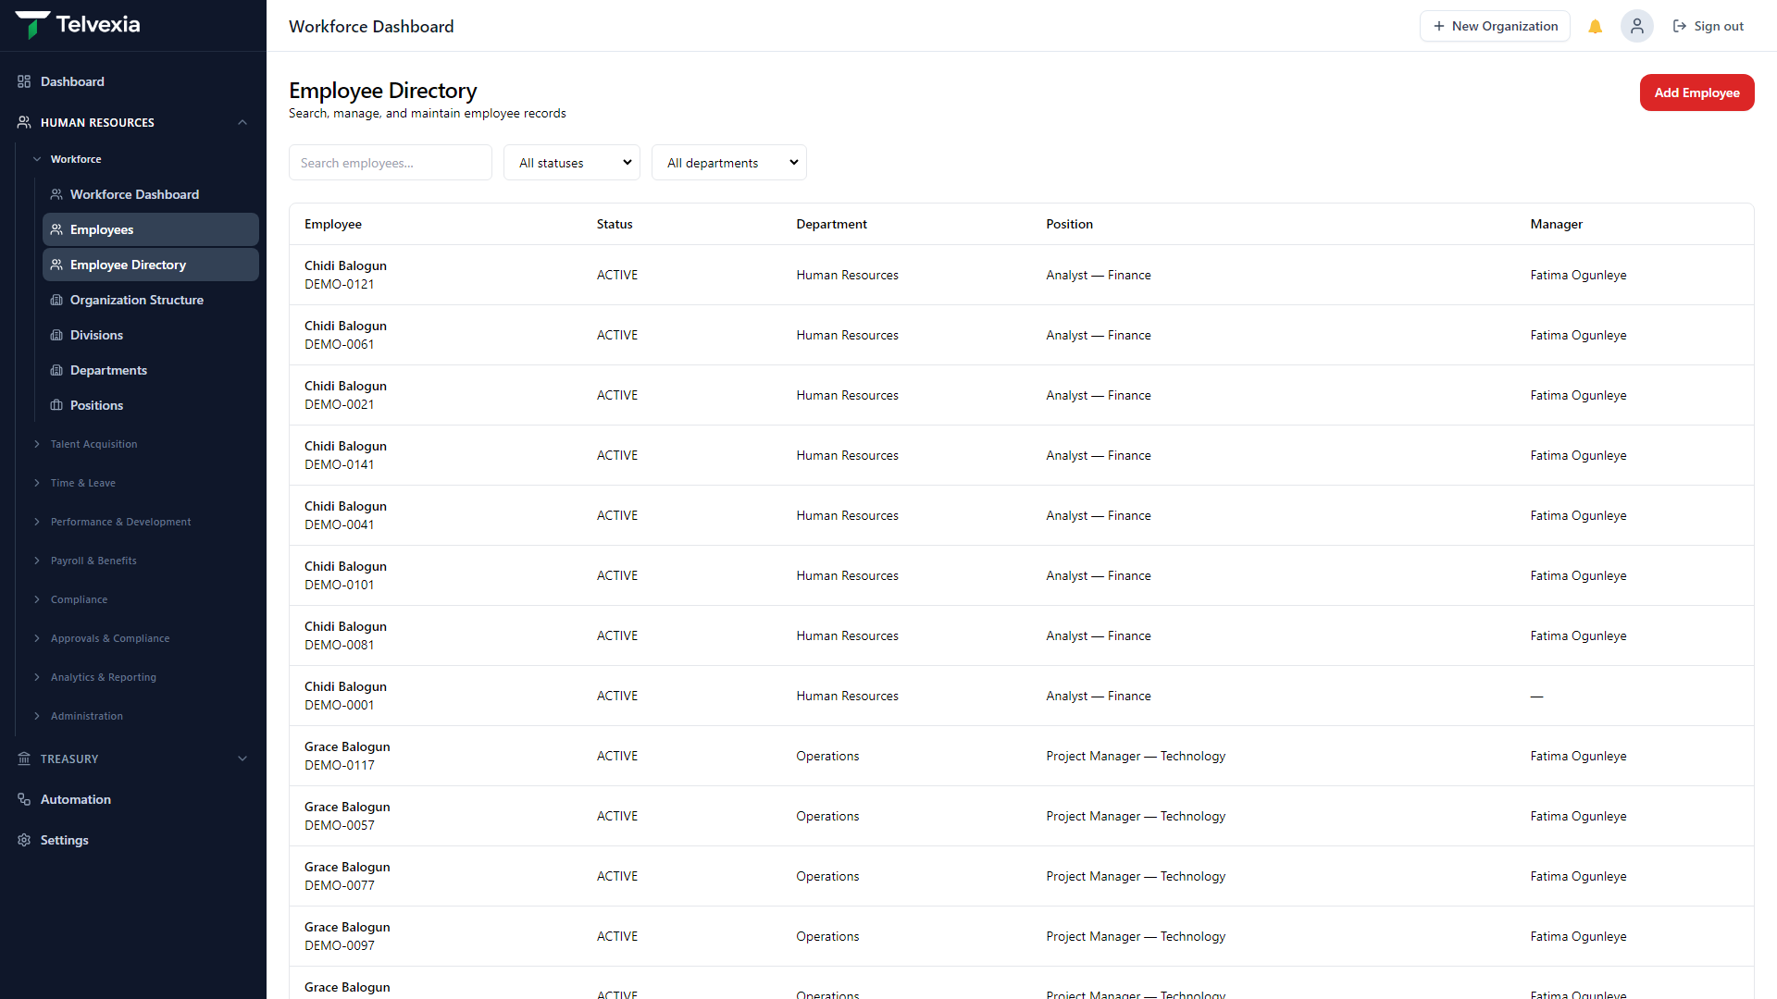
Workforce Platform
Outcome: One record for every employee — from hire to retire
Employee records, recruitment, attendance, leave, performance, and learning
Employee self-service for managers and staff
Organisational structure aligned to payroll and compliance
Reduce HR–payroll disconnect and manual rework
Telvexia Workforce — telvexia.com

Slide 5
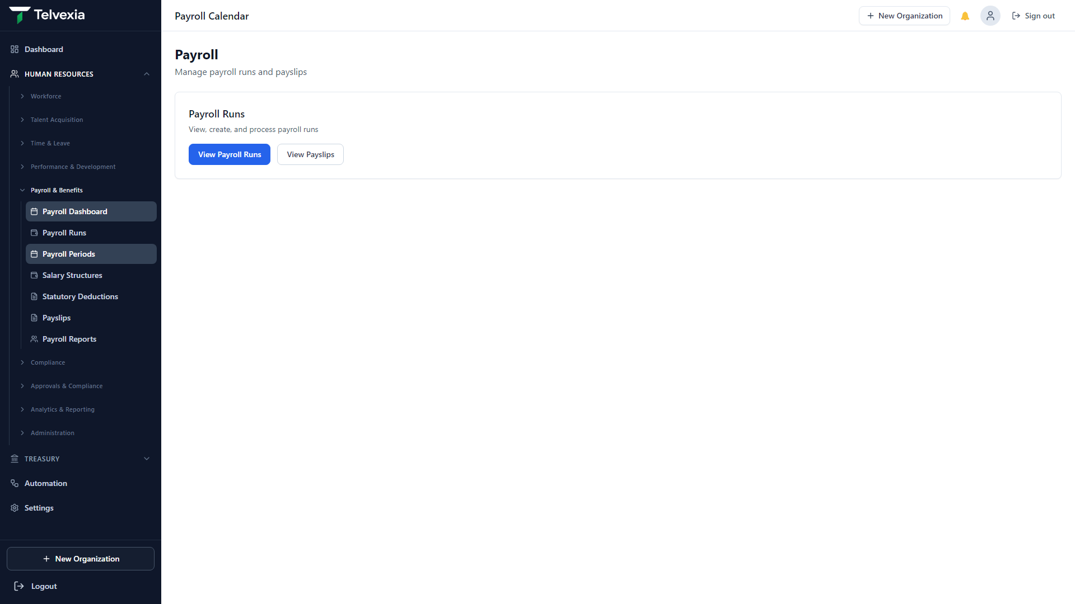
Payroll Platform
Outcome: Close payroll with confidence and control
Payroll engine with salary structures and gross-to-net calculations
Multi-level approvals before lock and remittance
Payslips with full statutory deduction breakdown
Payroll locking for audit-ready month-end close
Telvexia Workforce — telvexia.com

Slide 6
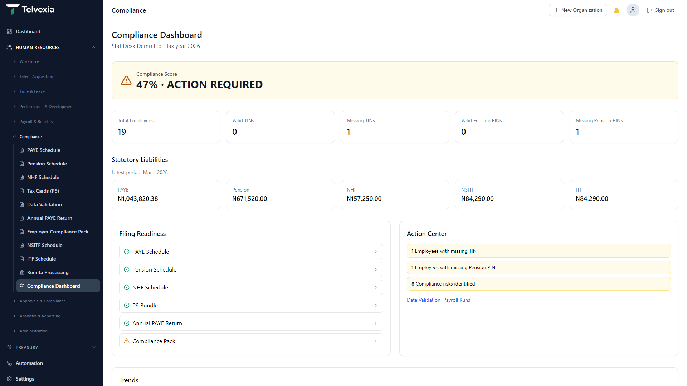
Compliance Platform
Outcome: Boardroom-ready statutory reporting without spreadsheets
PAYE, pension, NHF, NSITF, ITF schedules from locked payroll
Annual returns, P9 tax cards, and employer compliance packs
Compliance dashboard with validation before month-end lock
Traceable exports for auditors and regulators
Telvexia Workforce — telvexia.com

Slide 7
Integration Platform
Outcome: Connect finance and payments without rework
Accounting — journal export to Zoho, QuickBooks, Sage, and Xero
Payments — salary schedules for Remita, Paystack, Flutterwave, and more
API, webhooks, notifications, and connected apps
Enterprise integration without changing core payroll logic
Telvexia Workforce — telvexia.com

Slide 8
Intelligence Platform
Coming Soon — Outcome: Workforce intelligence for leaders
Executive analytics across workforce, payroll, and compliance
AI assistant for operational and compliance queries
Predictive insights on workforce costs and risk
Workforce analytics for CFO and HR leadership
Telvexia Workforce — telvexia.com

Slide 9
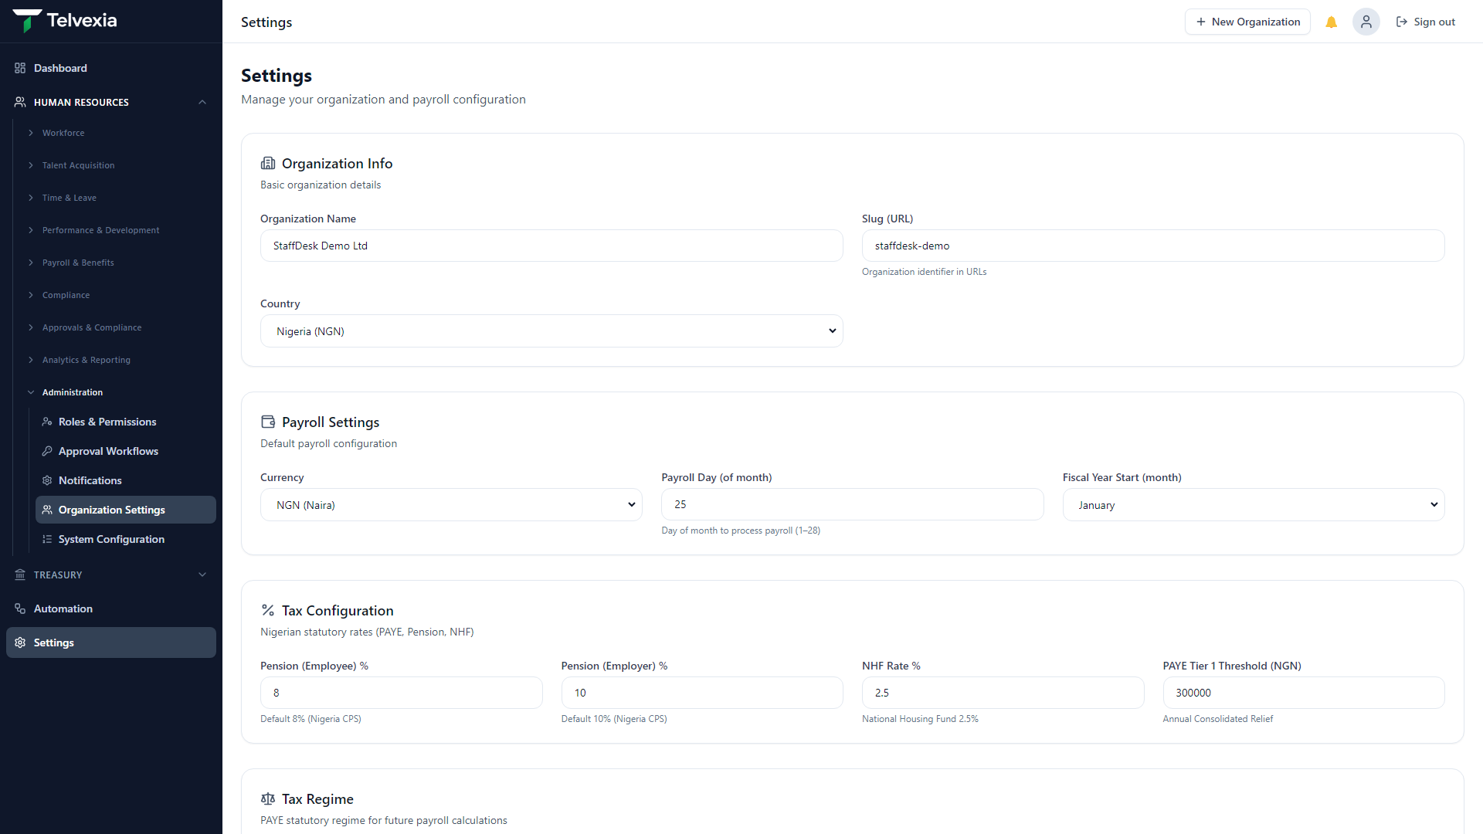
Technology Platform
Powered by TaxCore™
Nigeria's intelligent payroll and compliance engine
Deterministic, test-certified PAYE and statutory calculations
Configurable tax regime settings per organisation
Reconciliation between payroll totals and compliance exports
Telvexia Workforce — telvexia.com

Slide 10
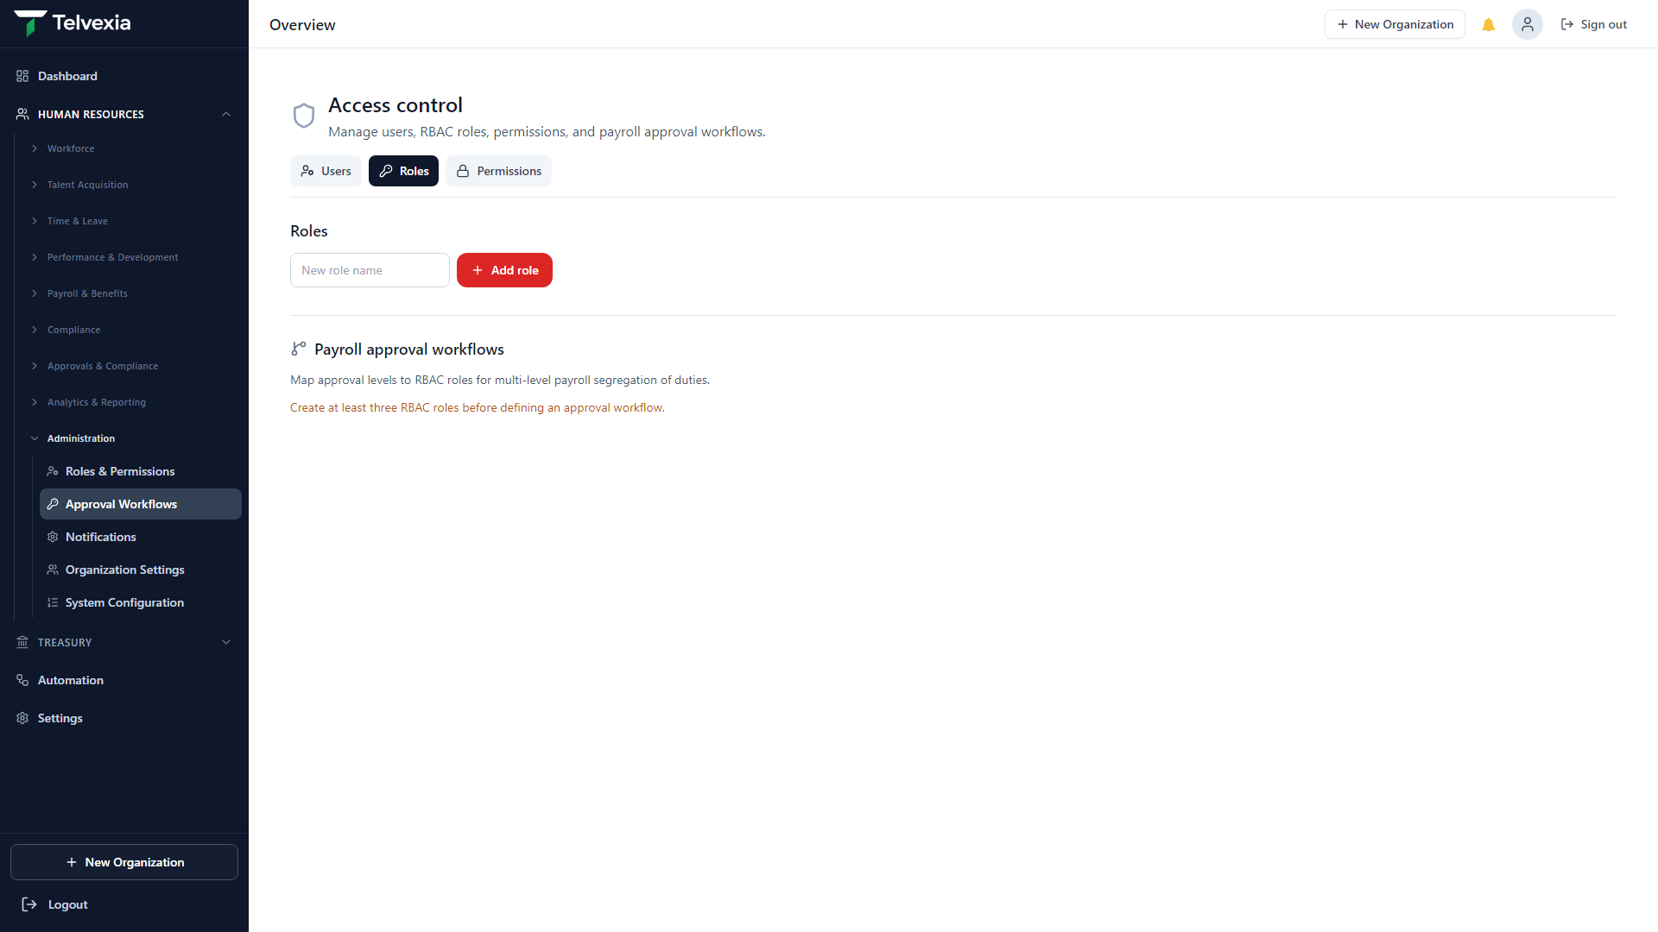
Security & Governance
Role-based access control with granular permissions
User management and organisation settings
Immutable audit logs for sensitive actions
Multi-tenant isolation and secure authentication
Telvexia Workforce — telvexia.com

Slide 11
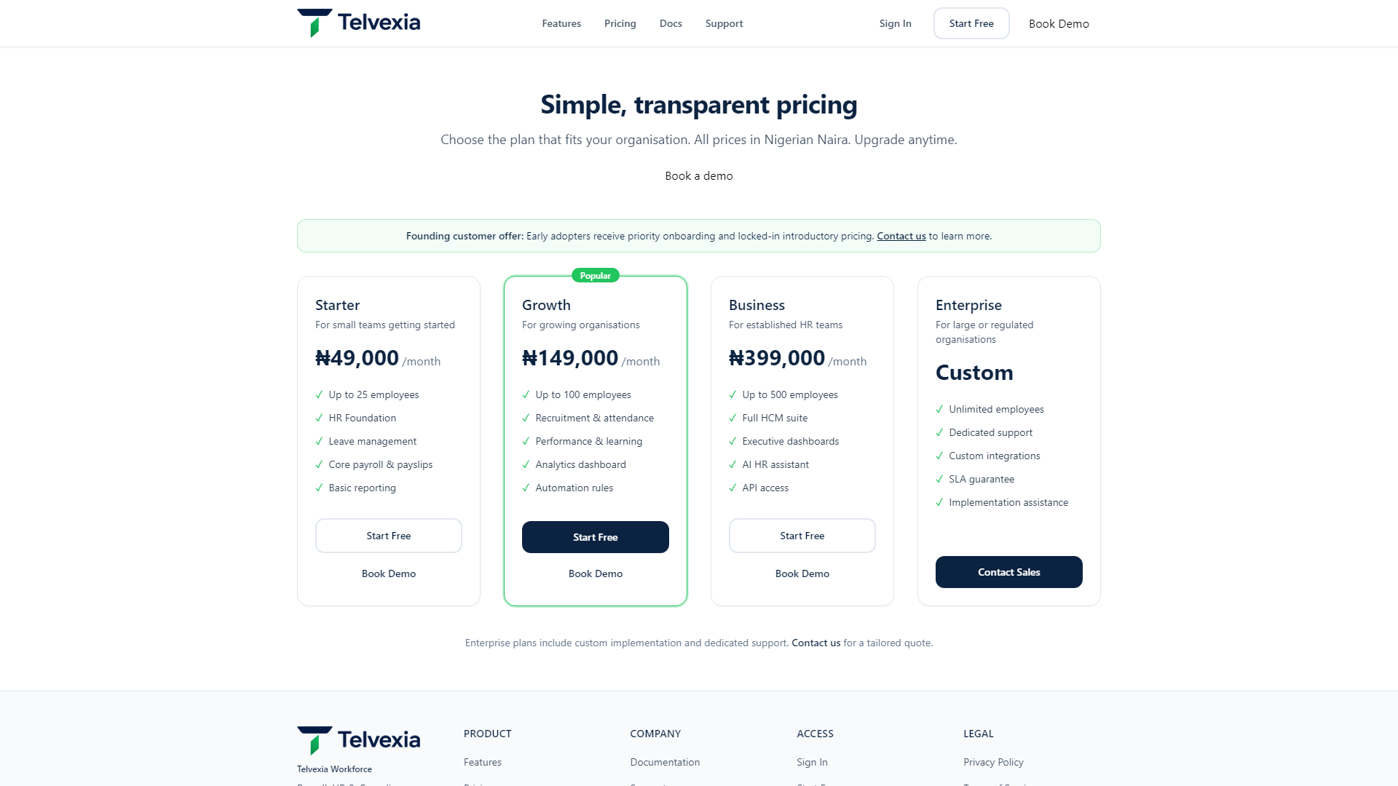
Pricing
Starter — small teams up to 25 employees
Growth — scaling businesses with advanced workflows
Business — mid-market with analytics and approvals
Enterprise — custom implementation and dedicated support
Telvexia Workforce — telvexia.com

Slide 12
Founding Customer Program
Preferential pricing for early adopters
Priority onboarding and dedicated success contact
Direct input into product roadmap
Co-marketing opportunities for reference customers
Limited availability — apply via telvexia.com/contact
Telvexia Workforce — telvexia.com

Slide 13
Implementation Approach
Week 1: Organisation setup, users, and org structure
Week 2: Employee data migration and salary structures
Week 3: Parallel payroll run and compliance validation
Week 4: Go-live with locked payroll and statutory exports
Ongoing: Support, training, and quarterly business reviews
Telvexia Workforce — telvexia.com

Slide 14
Founder Profile
Rotimi Odunsi, FCA, CISA
Chartered Accountant
Chartered Tax Practitioner
20+ years experience
ERP & Financial Systems Specialist
Government Revenue Systems Experience
Founder, Telvexia
Telvexia
Building Nigeria's workforce
platform of record
Telvexia Workforce — Confidential

Slide 15
Roadmap
H2 2026: Treasury remittances and bank reconciliation
H2 2026: Advanced analytics and executive dashboards
2027: ERP connectors and multi-entity consolidation
2027: Mobile employee self-service enhancements
Continuous: TaxCore updates for regulatory changes
Telvexia Workforce — telvexia.com

Slide 16
Next Steps
Book a 15-minute product demonstration
Start a free trial at telvexia.com/signup
Discuss Founding Customer Program eligibility
Contact: telvexia.com/contact
Thank you

